Slide 1
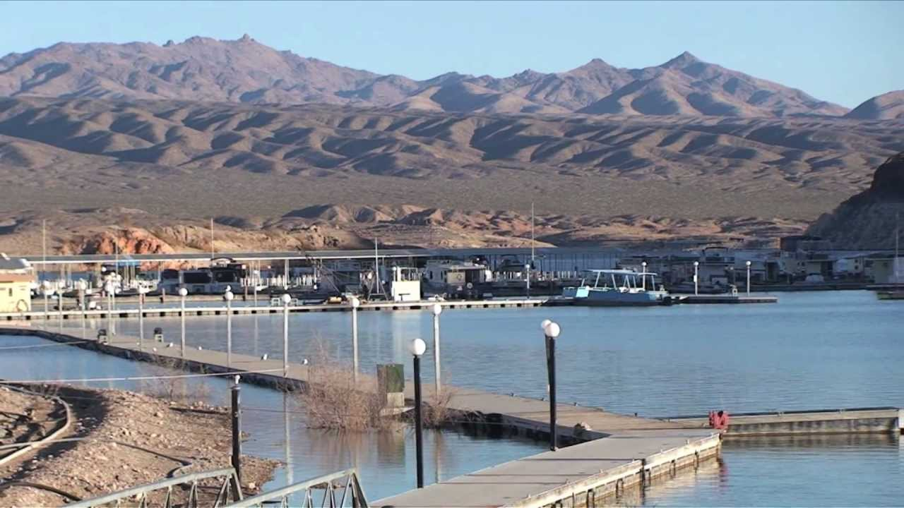
ECHO BAY – Zone Capturing

Slide 2
Briefing “Blue” Coalition
Your mission “Echo Bay” is to fly towards the airbase and capture 5 random zones that are placed at the airbase.
Zones can be captured by destroying every unit within the zone, and then fly or drive into the zone and hold until the zone is captured.
Once the zone is captured by your coalition, new fuel tanks will spawn in. Expect the RED coalition to initiate defenses.
Once all 5 zones are captured, but mission is complete and your coalition
IS THE WINNER!

Slide 3
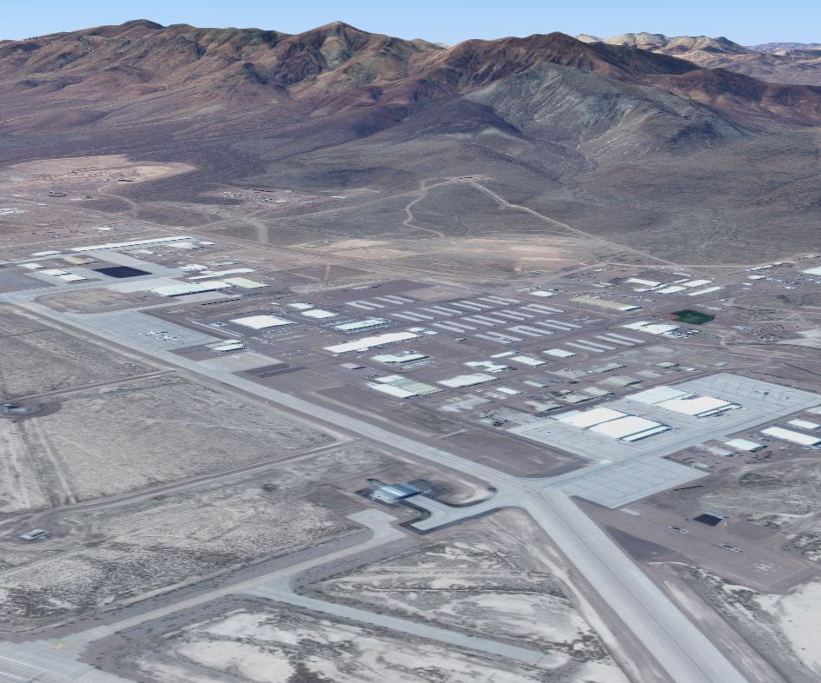
AREA 51 – Satelite Image
ZONES

Slide 4
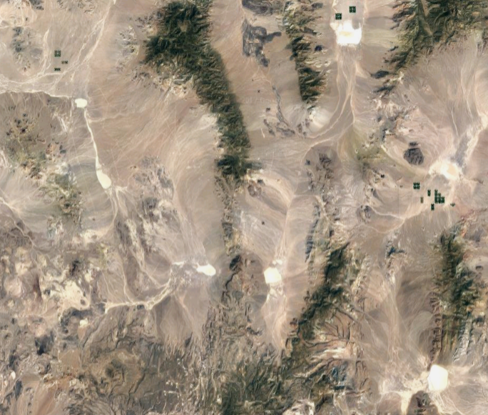
AREA 51 – Satelite Image
Air Defenses
Air Defenses

Slide 5
AREA 51 – Satelite Image
Locations Enemy Ground Forces

Slide 6
AREA 51 – Satelite Image
A2A Attack

Slide 7
AREA 51 – Satelite Image
A2G Attack Locations

Slide 8

A creation using MOOSE

